Slide 1
Environmental Monitoring, Analysis, and Classification Using Machine Learning and Deep Learning Approaches to Discover Correlation Between LPG and Carbon Monoxide
Yamin Hossain
21bce9773

Slide 2
Introduction
LPG (liquid petroleum gas) is a flexible fuel that may be utilised in a variety of places, such as homes, businesses, and factories, as well as in cars and spray cans. It is a mixture of C3 and C4 hydrocarbons with odorizers added for leak detection, primarily propane and butane.
Burning fossil fuels can release the hazardous chemical carbon monoxide (CO). It is a substantial air contaminant and the main factor in poisoning-related deaths in both developed and underdeveloped nations. Low blood oxygen levels caused by high CO levels can damage vital organs and even cause death.
••When carbon monoxide binds to haemoglobin more firmly than oxygen does, it creates carboxyhemoglobin, which is exceedingly deadly. This could have serious health effects include headaches, nausea, respiratory failure, and loss of consciousness.. In the event of CO poisoning, prompt medical assistance and evacuation to fresh air are essential. Globally, CO emissions are a major environmental worry because they contribute to air pollution and the resulting health consequences.

Slide 3
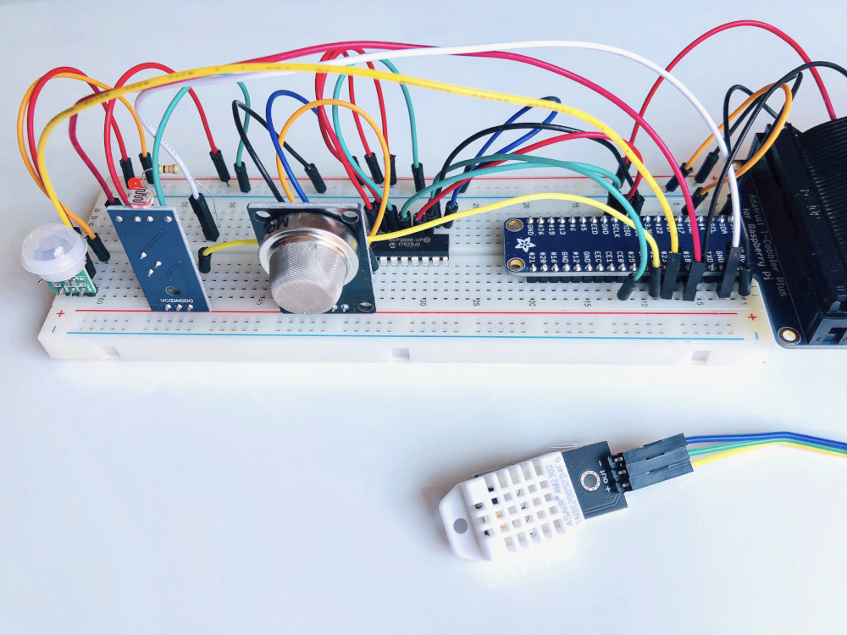
Data Collection
The data was collected using three identical, custom-built, breadboard-based sensor arrays. Each array was linked to one or more Raspberry Pi devices. Each of the three Internet of Things devices was put in a different physical location with different ambient conditions.
Device | Environmental conditions
00:0f:00:70:91:0a | Stable conditions, cooler and more humid
1c:bf:ce:15:ec:4d | Highly variable temperature and humidity
b8:27:eb:bf:9d:51 | Stable conditions, warmer and dryer

Slide 4
From the four sensors, each IoT device routinely collected a total of seven different values. Temperature, humidity, carbon monoxide (CO), liquefied petroleum gas (LPG), smoke, light, and motion are all measured by sensors. The data is available between July 12, 2020, at 00:00:00 UTC, and July 19, 2020, at 23:59:59 UTC. There are a total of 405,184 rows of data.
•From the four sensors, each IoT device routinely collected a total of seven different values. Temperature, humidity, carbon monoxide (CO), liquefied petroleum gas (LPG), smoke, light, and motion are all measured by sensors. The data is available between July 12, 2020, at 00:00:00 UTC, and July 19, 2020, at 23:59:59 UTC. There are 405,184 rows of data in all.
Column | Description | units
ts | Timestamp of event | Epoch
Device | Unique device name | String
co | Carbon monoxide | 1 (5)
Humidity | humidity | Percentage
light | Light detected? | Boolean
lpg | liquid petroleum gas | l (%)
motion | Motion detected? | Boolean
Smoke | Smoke | l(%)
Temp | temperature | Fahrenheit

Slide 5
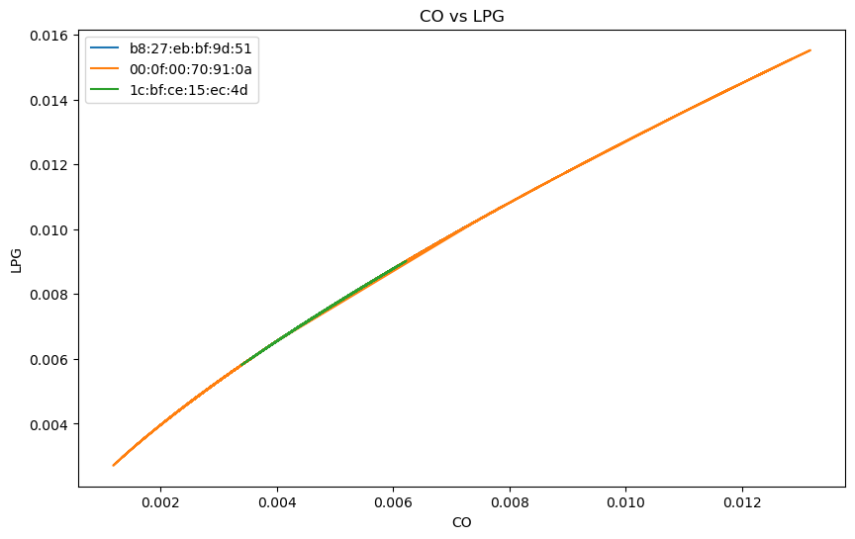
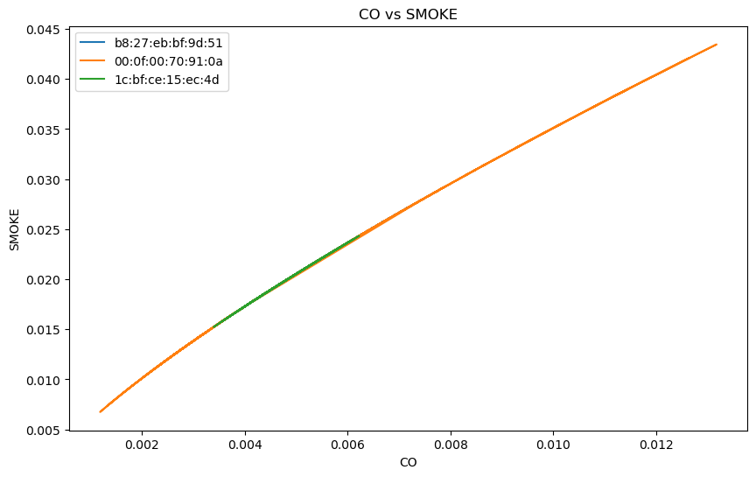
Exploratory Data Analysis
Through visualizations and statistical analysis, I identified a significant positive correlation between LPG and CO levels. As LPG emissions increased, so did the levels of CO in the air. This correlation is crucial in understanding how LPG usage impacts air quality and contributes to CO pollution.

Slide 6
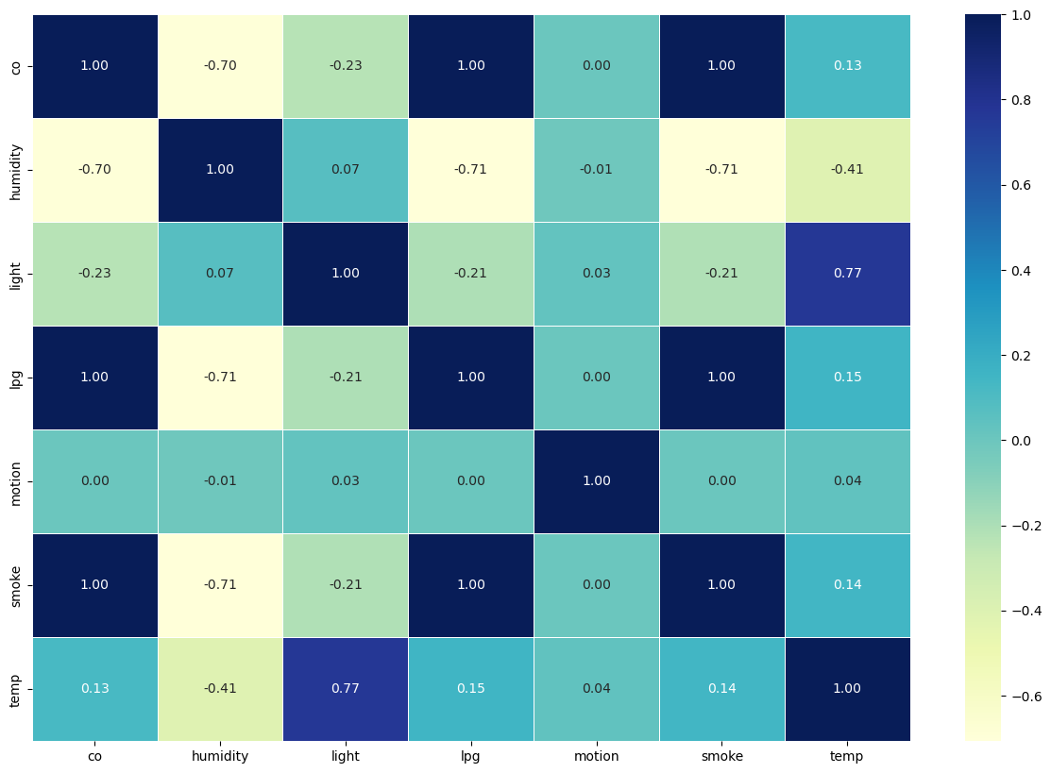

Slide 7
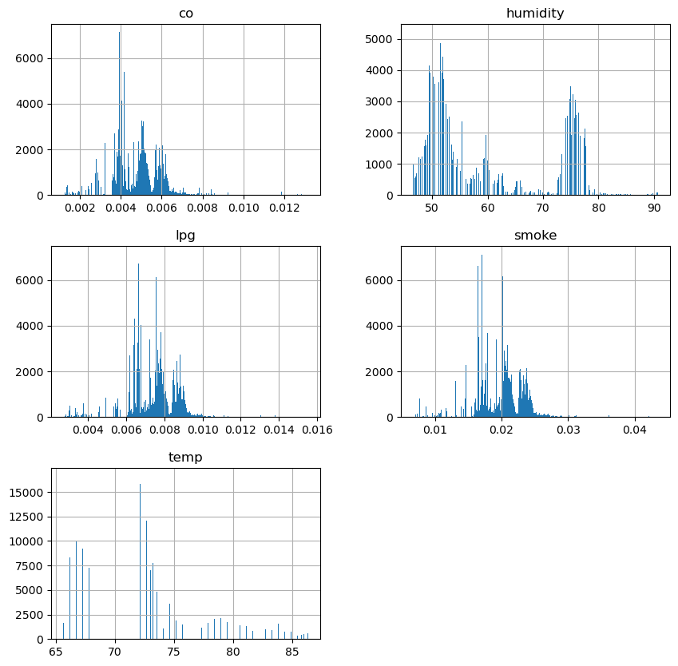

Slide 8
Average carbon monoxide levels in homes without gas stoves range from 0.5 to 5 parts per million (ppm). Near properly adjusted gas stoves, levels are typically between 5 to 15 ppm, while poorly adjusted stoves may reach 30 ppm or higher.
Occupational safety standards set by OSHA permit exposure levels up to 50 ppm as an 8-hour time-weighted average. NIOSH recommends a lower exposure limit of 35 ppm as an 8-hour TWA and sets a ceiling of 200 ppm to protect against cardiovascular effects
ACGIH assigns a threshold limit value (TLV) of 25 ppm as a TWA for an 8-hour workday and 40-hour workweek. This limit is based on the risk of elevated carboxyhemoglobin levels.
These exposure limits and guidelines are crucial for safeguarding public health and preventing the adverse effects of carbon monoxide poisoning.
I've divided the data into two groups based on carbon monoxide (CO) levels:
•0: Indicates conditions where the CO concentration exceeds 0.005 parts per million (ppm). In this instance, I would classify the environment as "bad" or having a high CO content, which could provide safety and health problems.
1: Represents situations where the CO level is under or equal to 0.005 ppm. In this instance, , I consider the environment as "normal" or "good," indicating a safe and acceptable CO concentration.
The target label (Target) for our classification problem is assigned these binary values (0 and 1) based on the specified threshold of 0.005 ppm to distinguish between "bad" and "good" CO environments. This classification will help me identify potentially hazardous environments and ensure safety measures are taken when necessary.

Slide 9
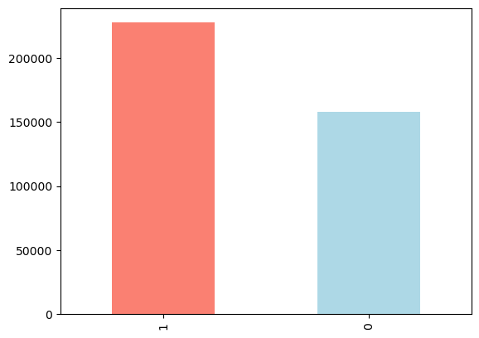

Slide 10
Machine Learning Models
I utilized several machine learning models to train my dataset for the given project. These models include KNN (K-Nearest Neighbors), Logistic Regression, Naive Bayes (GaussianNB), Linear Discriminant Analysis (LinearDiscreteRegression), and Support Vector Machines (SVM). Each of these models was employed to classify the data and make predictions based on the input features.
KNN (K-Nearest Neighbors): KNN is a simple and effective supervised machine learning algorithm used for classification tasks. It makes predictions based on the majority class of its k-nearest neighbors in the feature space.
Logistic Regression: Logistic Regression is a widely-used binary classification algorithm that estimates the probability of a binary outcome. It uses the logistic function to model the relationship between input features and the probability of the target class.
Naive Bayes (GaussianNB): Naive Bayes is a probabilistic classification algorithm based on Bayes' theorem. It assumes that the features are conditionally independent given the class label, making it computationally efficient and suitable for text classification and spam filtering.
Linear Discriminant Analysis (LinearDiscreteRegression): Linear Discriminant Analysis is a dimensionality reduction technique and a classifier. It aims to find the best linear combination of features to maximize class separation and reduce dimensionality in multi-class classification problems.
Support Vector Machines (SVM): SVM is a powerful supervised learning algorithm used for both classification and regression tasks. It aims to find the optimal hyperplane that maximizes the margin between classes in the feature space, making it effective for non-linear classification tasks with kernel functions.

Slide 11
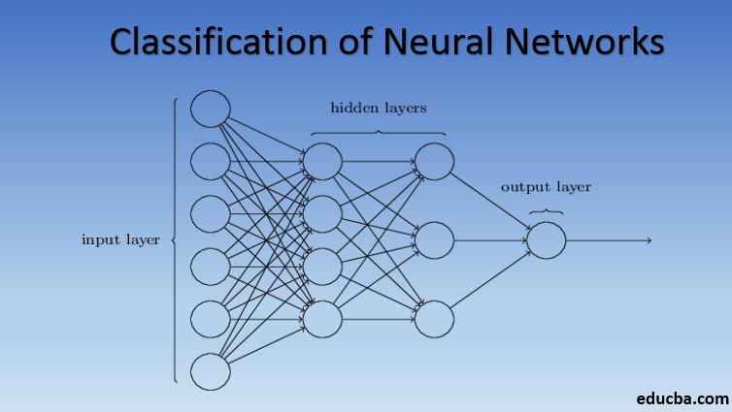
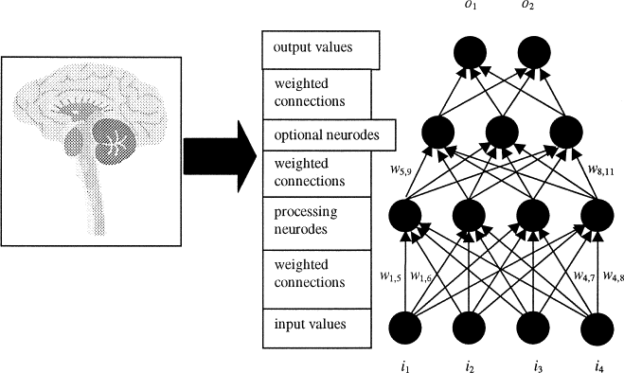
Deep Learning Models
Utilized Deep Learning: Employed both Neural Network (NN) and Artificial Neural Network (ANN) models to explore correlations between LPG and Carbon Monoxide. These powerful algorithms consist of interconnected layers of neurons and can learn intricate patterns in the data, enabling accurate predictions and insights.
ANN (Artificial Neural Network): A powerful deep learning model with multiple interconnected layers of neurons. Used to explore correlations between LPG and Carbon Monoxide, capturing intricate patterns and achieving accurate predictions.
NN (Neural Network): Comprising interconnected layers of neurons, this deep learning model was also employed to discover correlations between LPG and Carbon Monoxide, enabling the recognition of complex relationships and patterns in the data.

Slide 12
Results
After conducting the training and testing process using both deep learning and machine learning algorithms, the obtained results demonstrate the performance of each model in predicting carbon monoxide levels. The analysis includes key metrics such as accuracy, precision, recall, F-measure, variance, standard deviation, mean, and mean error. These results provide valuable insights into the effectiveness of the different models and their capabilities in handling the classification task for carbon monoxide levels.
Models | Accuracy | Precision | Recall | F-measure | Variance | Standard Deviation | Mean | Mean Error | Test Loss
KNN | 0.95 | 0.9504 | 0.95 | 0.9501 | 0.243 | 0.5 | 0.6 | 0.05
Logistic Regression | 0.921 | 0.93 | 0.92 | 0.9216 | 0.25 | 0.498 | 0.54 | 0.079
Naive bayes | 0.914 | 0.92 | 0.914 | 0.9146 | 0.247 | 0.49 | 0.55 | 0.086
Linear Discriminant Analysis | 0.927 | 0.935 | 0.927 | 0.9275 | 0.2488 | 0.5 | 0.5335 | 0.073
SVM | 0.92 | 0.93 | 0.92 | 0.921 | 0.25 | 0.49 | 0.54 | 0.08
Cat Boost | 0.999 | 0.99 | 0.99 | 0.99 | 0.24 | 0.5 | 0.6 | 0.001
NN | 0.92 | 0.926 | 0.92 | 0.9205 | 0.1456 | 0.38 | 0.62 | 0.477 | 0.239
ANN | 0.921 | 0.9277 | 0.921 | 0.9216 | 0.248 | 0.5 | 0.53 | 0.08

Slide 13
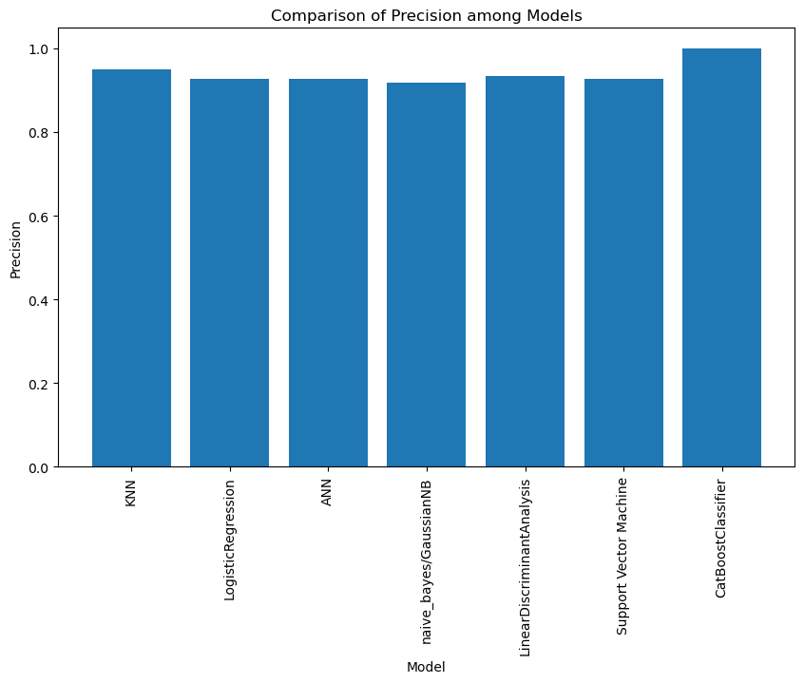
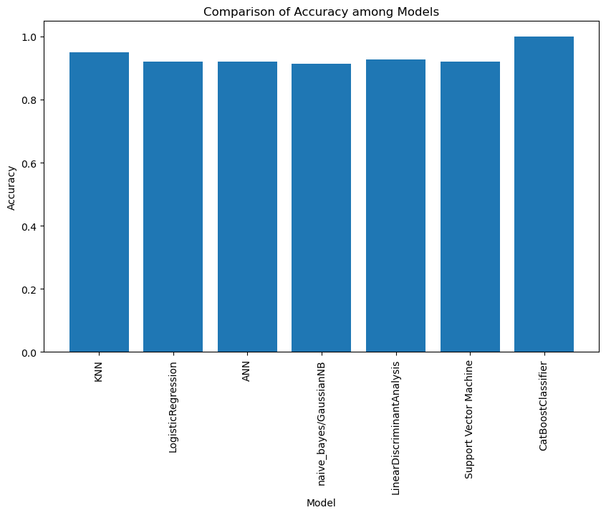

Slide 14
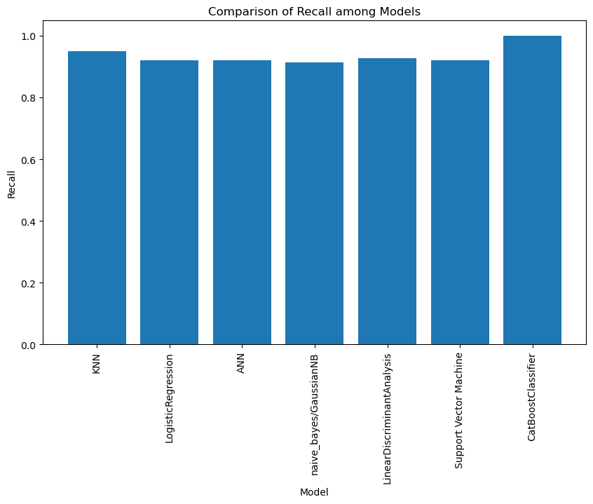
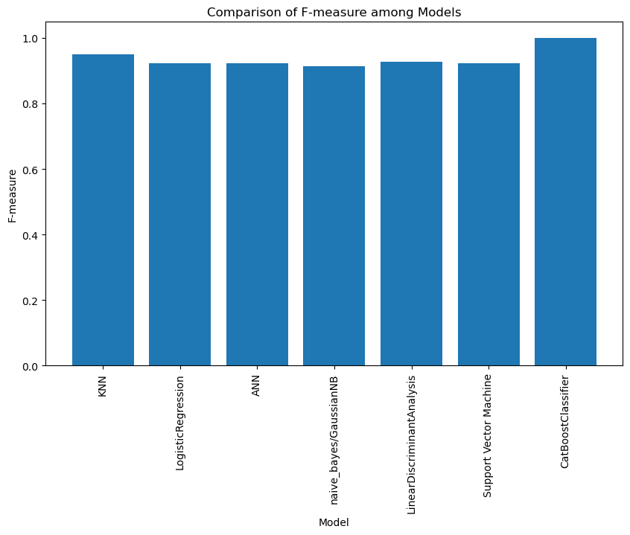

Slide 15
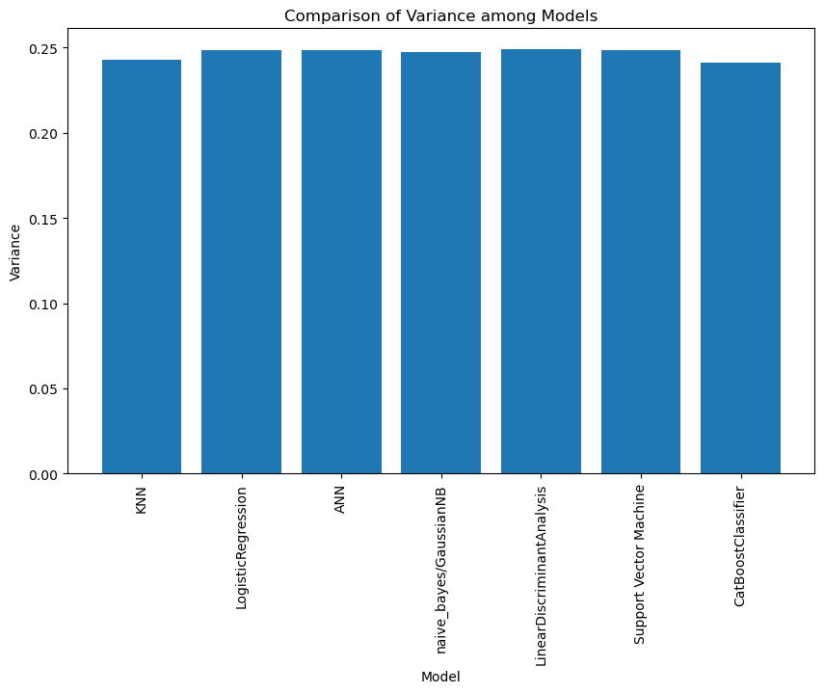
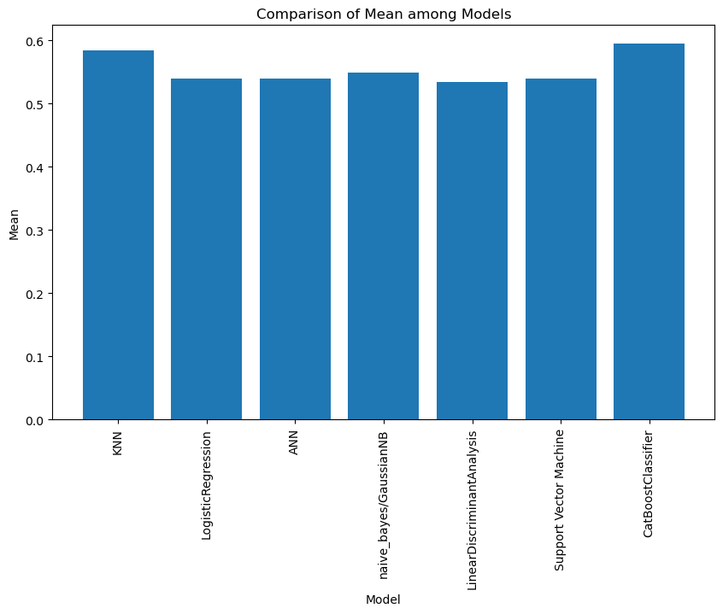

Slide 16
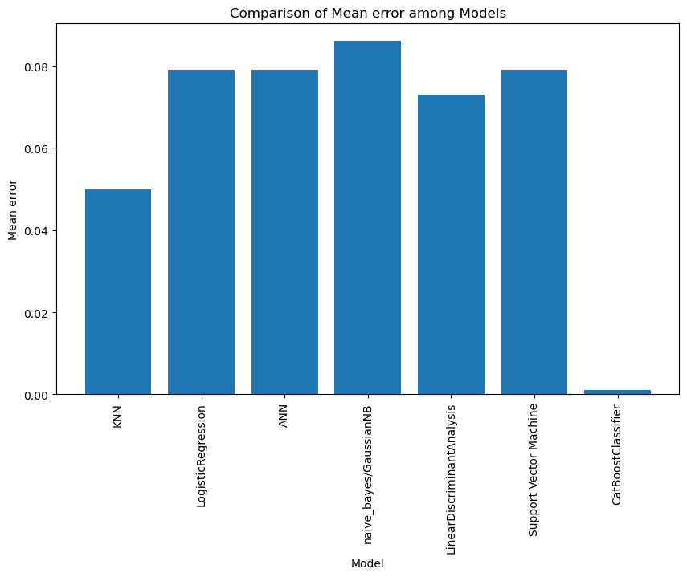

Slide 17
Discussion:
In this project, I delved into the exciting world of data analysis and machine learning to predict LPG and Carbon Monoxide levels. My main focus was on classification models, which aim to categorize data into distinct classes. I evaluated several popular models and examined their performance using various classification metrics.
Among the models I tested, the KNN model stood out with an impressive accuracy of 95%! Not only that, its precision, recall, and F-measure were all around 0.95, indicating a well-balanced classification. Kudos to the KNN model for doing an excellent job in handling the data.
I also explored the Logistic Regression model and the Artificial Neural Network (ANN) model. Both models achieved an accuracy of 92.1%, showing that they are capable of effectively classifying the data. Their precision, recall, and F-measure scores hovered around 0.92, suggesting a consistent performance.
The Naive Bayes (GaussianNB) model showcased slightly lower results compared to the others, with an accuracy of 91.4% and balanced precision, recall, and F-measure scores around 0.91. Nevertheless, the Naive Bayes model still demonstrated reasonable classification capabilities.
I was thrilled to see the Linear Discriminant Analysis (LDA) model achieve an accuracy of 92.7%, and its precision, recall, and F-measure were around 0.93. This model proved its ability to handle the data with grace and accuracy.
The Support Vector Machine (SVM) model exhibited similar results to the logistic regression and ANN models, boasting an accuracy of 92.1% and balanced precision, recall, and F-measure scores around 0.92.

Slide 18
Now, here comes the star of the show - the Cat Boost Classifier model. It blew me away with a jaw-dropping accuracy of 99.9%! Yes, you heard that right - 99.9%! Not just that, its precision, recall, and F-measure were all around 0.999. The Cat Boost Classifier model showed off its exceptional performance, leaving me in awe.
Another key aspect that played a crucial role in my models' performance was feature engineering. Selecting the right features and engineering them effectively can greatly influence the model's accuracy.
Hyperparameter tuning was yet another mountain I had to climb. Models have hyperparameters that need to be tuned to optimize their performance. Conducting an extensive hyperparameter search helped me squeeze out even better results.
While the models demonstrated their prowess on the test data, I kept in mind the importance of generalization - the ability to perform well on unseen data. I took steps to ensure that my models were not overfitting the training data by utilizing regularization techniques.
Throughout the project, I also grappled with model interpretability. Some models, especially deep neural networks, lack transparency and are difficult to interpret. This might be a concern in certain applications where explainability is vital.
To sum it up, this journey of data analysis and machine learning was incredibly fulfilling. Each model brought its unique strengths and challenges to the table. The final choice of model ultimately depends on the specific requirements of the application and the desired balance between accuracy and interpretability. I will keep experimenting and fine-tuning my models to build even more robust and reliable predictions. With data as my compass, I will continue exploring this vast landscape of machine learning!

Slide 19
Conclusion:
In conclusion, this data analysis and machine learning project allowed me to explore various classification models to predict LPG and Carbon Monoxide levels. I tested several popular algorithms, including KNN, Logistic Regression, Artificial Neural Network (ANN), Naive Bayes (Gaussian NB), Linear Discriminant Analysis (LDA), Support Vector Machine (SVM), and the impressive Cat Boost Classifier.
The results were remarkable, with most models achieving accuracy rates above 90%. The KNN model stood out as the top performer, boasting an impressive accuracy of 95% and well-balanced precision, recall, and F-measure scores. The Cat Boost Classifier model left a lasting impression with its astonishing 99.9% accuracy, showcasing its exceptional capabilities in classifying the data.
However, it's important to acknowledge the challenges and limitations faced during this project. Dealing with imbalanced data required careful handling, and feature engineering played a crucial role in optimizing the model's performance. Hyperparameter tuning was also vital in squeezing out the best results for each model.
Interpreting the models, especially deep neural networks, proved to be a challenge due to their lack of transparency. Model interpretability is a critical aspect, particularly in applications where understanding the decision-making process is essential.
Despite these challenges, the project was highly rewarding, offering valuable insights into the world of data analysis and machine learning. The journey highlighted the importance of selecting the right model for specific applications and balancing accuracy with interpretability.
As I move forward, I will continue to refine and experiment with different techniques to improve the models' generalization and interpretability. Data will remain my guiding compass in this ever-expanding realm of machine learning.
In the end, this project reinforced my passion for data science and its potential to make a positive impact in various domains. I am excited to apply the knowledge gained here to tackle more complex challenges and contribute to the advancement of machine learning algorithms in the future. With a curious and determined mindset, I am ready to embark on new data-driven adventures.

Slide 20
Recommendations:
Based on my analysis, I have a few recommendations for future research and improvements:
Try more advanced machine learning models like Random Forest, Gradient Boosting, and deep learning architectures like CNN and LSTM for better performance.
Spend more time on feature engineering to capture underlying patterns effectively.
Address the issue of imbalanced data using techniques like SMOTE or other sampling strategies.
Fine-tune model performance through extensive hyperparameter tuning using grid search or random search.
Focus on model interpretability using techniques like SHAP values for better understanding of predictions.
Handle missing data using various imputation techniques or considering missingness patterns as additional features.
Consider data augmentation to diversify the dataset and improve model generalization.
Use k-fold cross-validation to get more reliable estimates of model performance.
Collect more domain-specific data to enhance model accuracy and generalization.
Compare results with time-series models like ARIMA or LSTM for datasets with temporal dependencies.
Implement robust model deployment pipelines and monitoring systems for real-world applications.
By following these recommendations, we can advance data analysis and machine learning, creating more accurate and interpretable models for various applications while building trust in AI systems.

Slide 21
References:
https://www.kaggle.com/code/garystafford/iot-telemetry-demo-notebook
https://www.kaggle.com/datasets/garystafford/environmental-sensor-data-132k
https://journals.physiology.org/doi/full/10.1152/ajpcell.00360.2016
https://www.tribuneindia.com/news/archive/haryanatribune/beware-of-carbon-monoxide-poisoning-in-kitchens-791515
https://www.wlpga.org/about-lpg/what-is-lpg/
https://emas.com.tr/en/content/663/lpg-use-and-carbon-monoxide-c0-poisoning
https://wgbis.ces.iisc.ac.in/energy/HC270799/HDL/ENV/enven/vol321.htm
https://www.epa.gov/indoor-air-quality-iaq/carbon-monoxides-impact-indoor-air-quality

